Slide 1
Anime Planet
By Abdallah Mustafa

Slide 2
objectives :
Data collection
Data Cleaning
Analyzing Data
Interpreting Results

Slide 3
Data Collection
Data is collected from Anime Planet site.
Done by beautifulSoup library; Python.
this data will show us name , number of episodes, rating, production year and description for all animes.

Slide 4
Data Futures
Name: the name of each anime .
TotalEpisodes: How many episodes on each anime.
Rating: Anime Rating
ProdYear: Production year
AnimeType: different type of anime whether TV, OVA, Movie, Or music.
DataID: Unique ID
DataType: Whether Anime or Manga (Currently All Data are Anime)
HtmlREF: reference for anime in Anime Planet Website.
Tag: Types of Genres that anime falls into.
Description: short notes of the incidents for every story.
Src: defines where exactly the data gotten and its production studio.

Slide 5
Data Cleaning
def StrToList(x):
try:
return eval(x)
except:
return x
df.tag = df['tag'].apply(StrToList)
Turn string to list.

Slide 6
Data Cleaning
Get the main Genre
r =requests.get('https://www.anime-planet.com/anime/all')
s = BeautifulSoup(r.text, 'html.parser')
MG =[]
for g in s.find('div', {'id':'multipletags'}).ul.find_all('li', attrs={'data-class': 'filter-tooltip'}):
MG.append(g.find('a').get_text())
MG

Slide 7
Data Cleaning
Create Dataset for main Genre
d1 = pd.DataFrame(columns=MG)
for name, i in zip(df.Name,df.tag):
if isinstance(i, list):
dic = dict(zip(MG,zeros))
dic['Name'] = name
for genre in i:
if genre in dic.keys():
dic[genre] = 1
d1 = d1.append(pd.DataFrame(pd.Series(dic)).transpose())
elif isinstance(i, float):
dic = dict(zip(MG,zeros))
dic['Name'] = name
d1 = d1.append(pd.DataFrame(pd.Series(dic)).transpose())
Creating new dataset
to obtain the values in numerical data

Slide 8
Data Cleaning
Filling the missing data
In SRC
Changing the non values to “other”
since it is unknown source.
df.Src.loc[df.Src.isnull()] = "Other"

Slide 9
Data Cleaning
Filling the missing data
IN Rating
Changing the non values to “0”
Since it is unknown Rating
to Anime.
df.Rating.fillna(0, inplace=True)

Slide 10
Data Cleaning
Filling the missing data
IN ProdYear
Sorting values then
Changing the non values to the next nearest values
Since it is unknown year
To production year.
df.sort_values(by='ProdYear', inplace=True)
df.ProdYear.fillna(method='ffill', inplace=True)

Slide 11
Data Cleaning
Turning column year into
float
Removing the question mark
df.ProdYear=df.ProdYear.apply(lambda x: str(x).split('-')[0])

Slide 12
Data Analyzing
What are the best rating animes?
Name | TotalEpisodes | Rating | ProdYear
Attack on Titan 3rd Season: Part II | 10 | 4.6 | 2019
Attack on Titan The Final Season | 16 | 4.6 | 2020
Demon Slayer: Kimetsu no Yaiba - Entertainment District Arc | 4 | 4.6 | 2021
Fruits Basket the Final Season | 13 | 4.6 | 2021
Fullmetal Alchemist: Brotherhood | 64 | 4.6 | 2009
Jujutsu Kaisen | 24 | 4.6 | 2020

Slide 13
Data Analyzing
which year anime starts being published?
1907

Slide 14
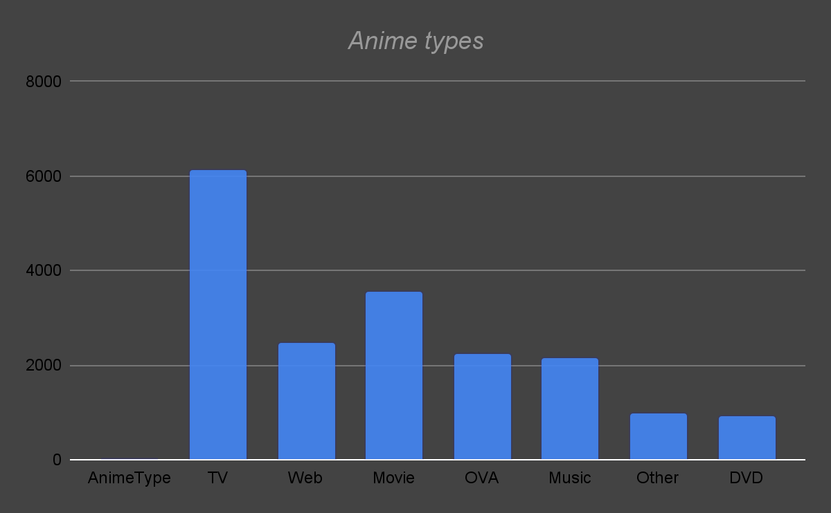
How many anime types in the data?

Slide 15
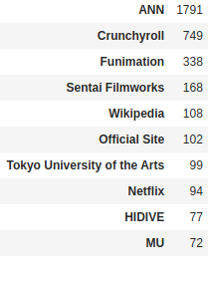
pd.DataFrame(df['Src'].value_counts()).head(10)
Clarifies the best sources for anime in the data
which source has more Anime in the data?

Slide 16
Name | TotalEpisodes | Rating | ProdYear | AnimeType
Sazae-san | 2633 | 3.2 | 1969 - ? | TV
Nintama Rantarou | 2204 | 3.6 | 1993 - ? | TV
Oyako Club | 1818 | 3.2 | 1994 | TV
Doraemon (1979) | 1787 | 3.5 | 1979 | TV
Ojarumaru | 1738 | 3.4 | 1998 - ? | TV
Kirin no Monoshiri Yakata | 1565 | 3.4 | 1975 | TV
Sore Ike! Anpanman | 1527 | 3.4 | 1988 - ? | TV
Kirin Ashita no Calendar | 1498 | 3.3 | 1980 | TV
what are the animes with the most episodes?

Slide 17
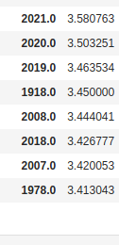
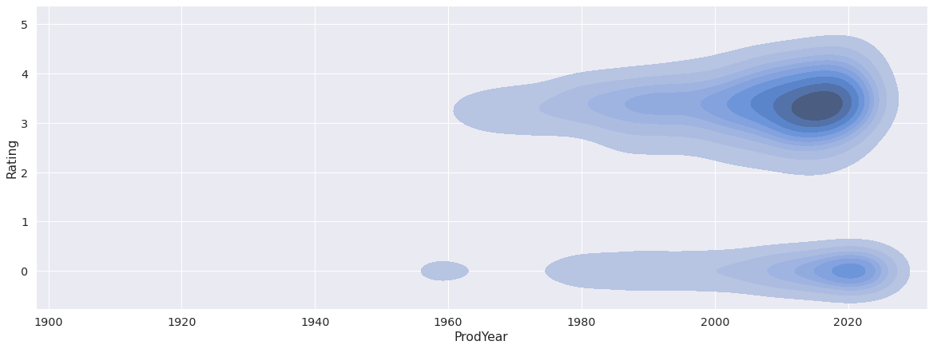
pd.DataFrame(df.groupby('ProdYear')["Rating"].mean()).sort_values(by='Rating', ascending=False).head(10)
which year that has animes with highest rates?

Slide 18
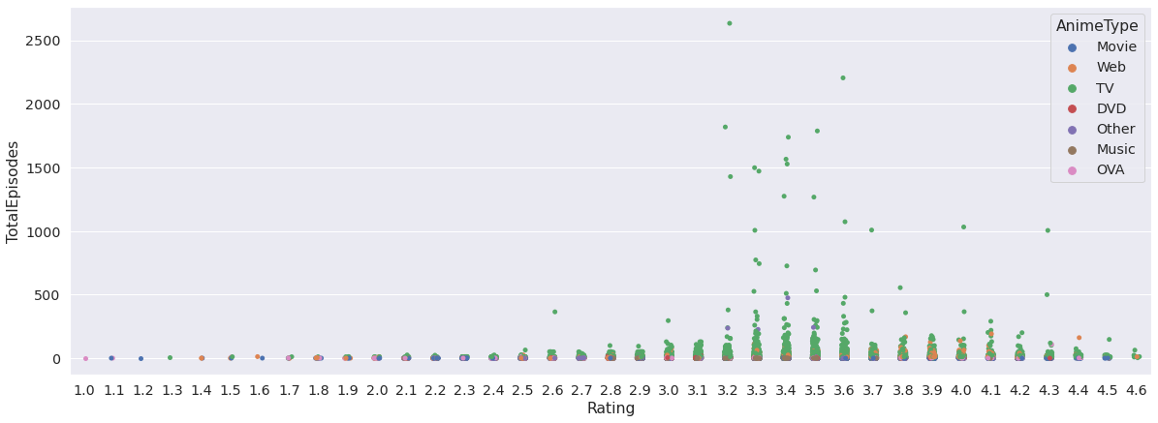
what is the relationship between number of episodes and rating?

Slide 19
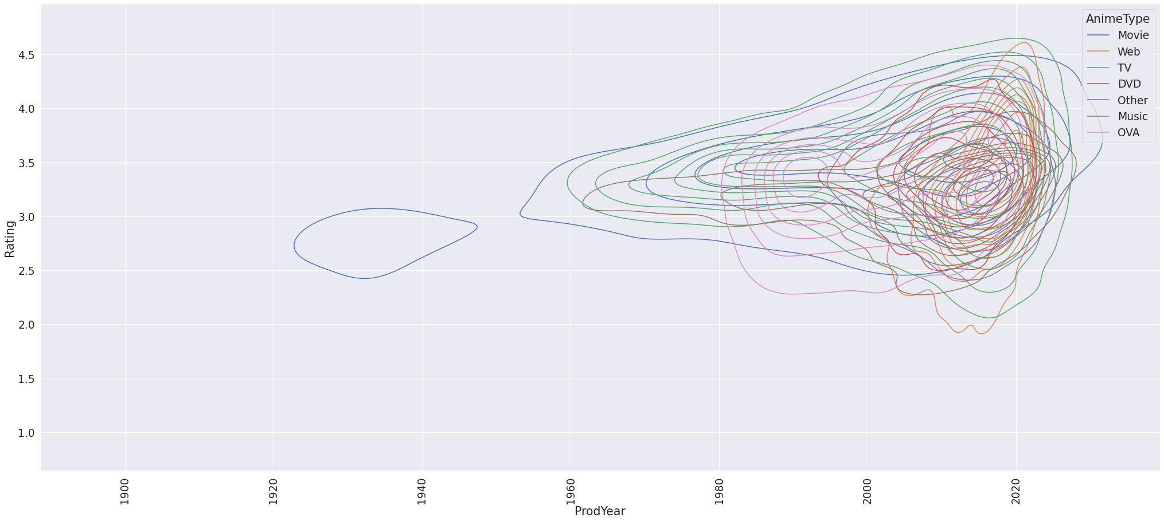
Relationship between rating and year in contrast with anime type

Slide 20
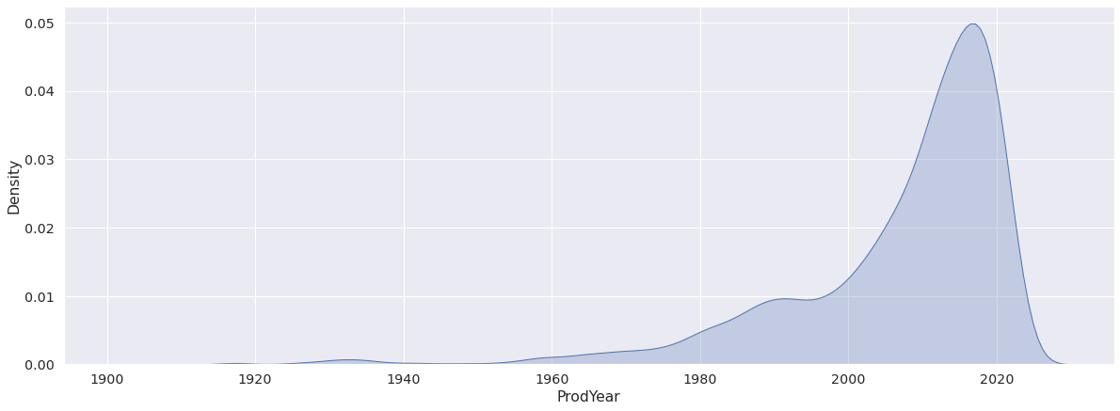
Year with highest production to anime

Slide 21
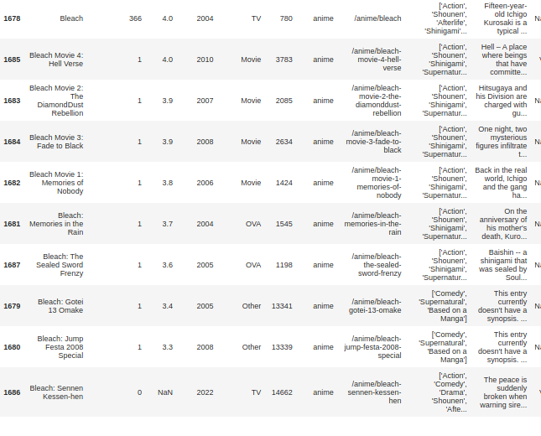
df.loc[df.Name.str.contains("bleach", case=False)].sort_values(by='Rating',ascending=False)
if you want to know specific anime based on name

Slide 22
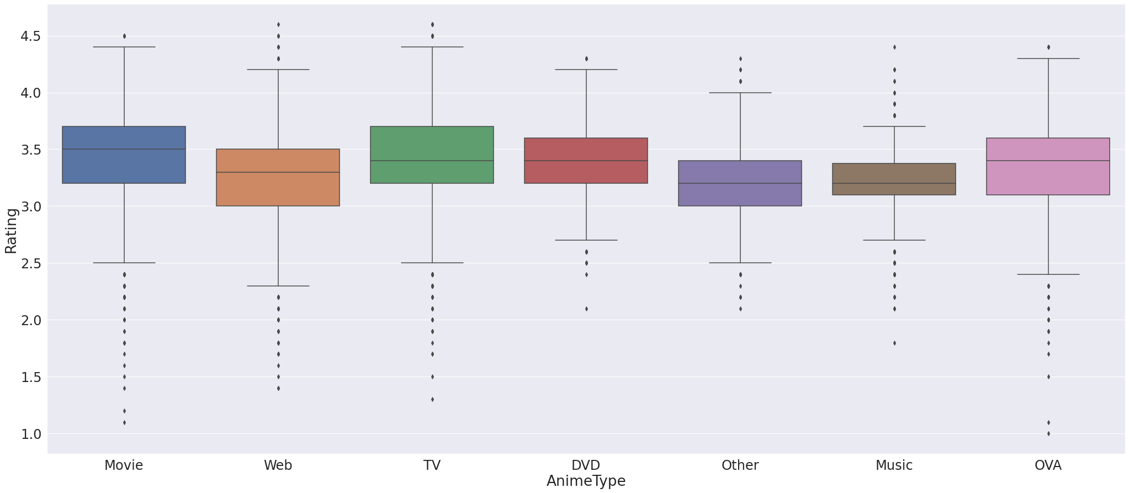
Relation between anime type and average rating

Slide 23
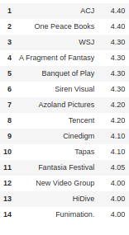
src = pd.DataFrame(df.groupby('Src')["Rating"].mean()).sort_values(by='Rating', ascending=False).head(15)
src = src.reset_index()
src
Group by the source then sorting it based on rating
what are the 10 best rating resources?

Slide 24
from itertools import combinations
from collections import Counter
count = Counter()
for row in df['tag']:
if isinstance(row, list):
count.update(Counter(combinations(row, 4)))
else:
continue
for key,value in count.most_common(15):
print(key, value)
('Animal Protagonists', 'Anthropomorphic', 'Family Friendly', 'Non-Human Protagonists') 345
('Comedy', 'Shounen', 'School Life', 'Based on a Manga') 208
('Animal Protagonists', 'Family Friendly', 'Non-Human Protagonists', 'Short Episodes') 201
('Comedy', 'Seinen', 'Slice of Life', 'Based on a Manga') 197
('Adventure', 'Animal Protagonists', 'Family Friendly', 'Non-Human Protagonists') 196
('Action', 'Mecha', 'Sci Fi', 'Original Work') 193
('Comedy', 'Animal Protagonists', 'Non-Human Protagonists', 'Short Episodes') 189
('Action', 'Comedy', 'Shounen', 'Based on a Manga') 178
('Comedy', 'Animal Protagonists', 'Anthropomorphic', 'Non-Human Protagonists') 170
('Action', 'Fantasy', 'Shounen', 'Based on a Manga') 164
('Fantasy', 'Magical Girl', 'Henshin Heroes', 'Magic') 160
('Action', 'Adventure', 'Shounen', 'Based on a Manga') 160
('Animal Protagonists', 'Anthropomorphic', 'Chinese Animation', 'Non-Human Protagonists') 156
('Action', 'Shounen', 'Superpowers', 'Based on a Manga') 154
('Animal Protagonists', 'Anthropomorphic', 'Non-Human Protagonists', 'Short Episodes') 152
what are the types that mostly comes with each other??

Slide 25
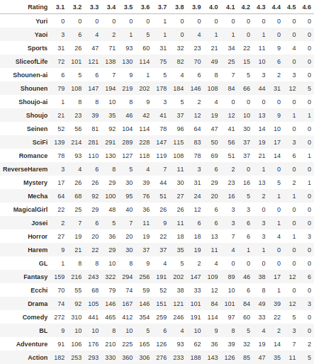
dfQuary.loc[dfQuary["Rating"] > 3].groupby(by="Rating").sum().transpose().iloc[2:]
Explains the relationship between
the Rating of anime and its genres
Rating and its relations with genres

Slide 26
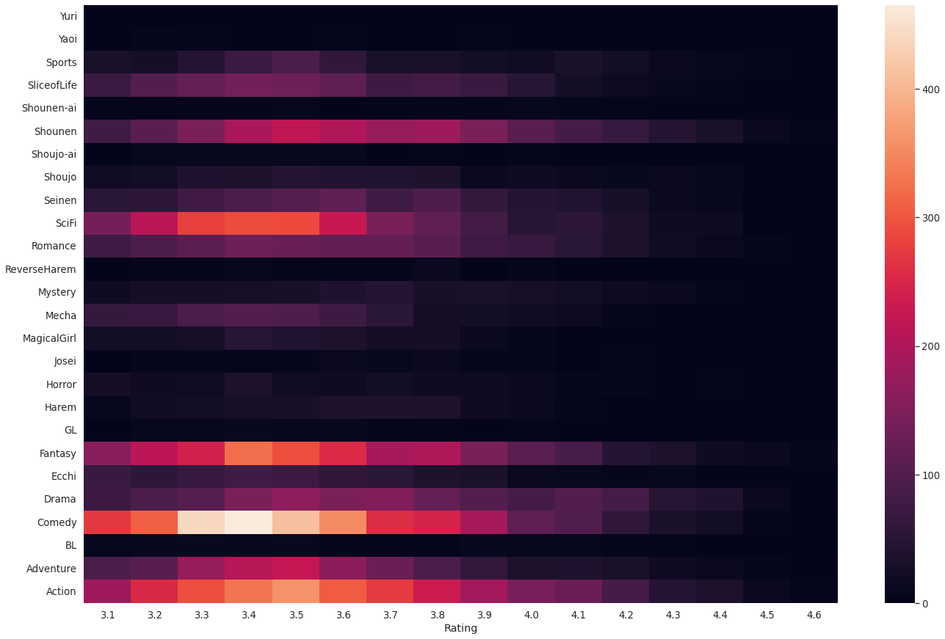
Heatmap for the rating and relationship with genres

